Slide 1
Applications of Neural Networks to Modulus on Networks
Abhinav Chand Kansas State University

Slide 2
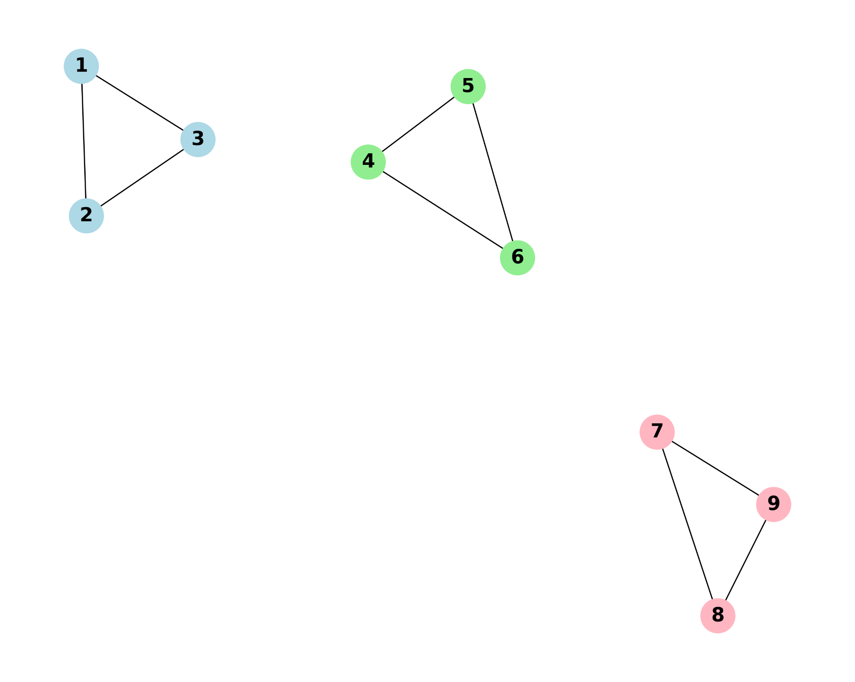
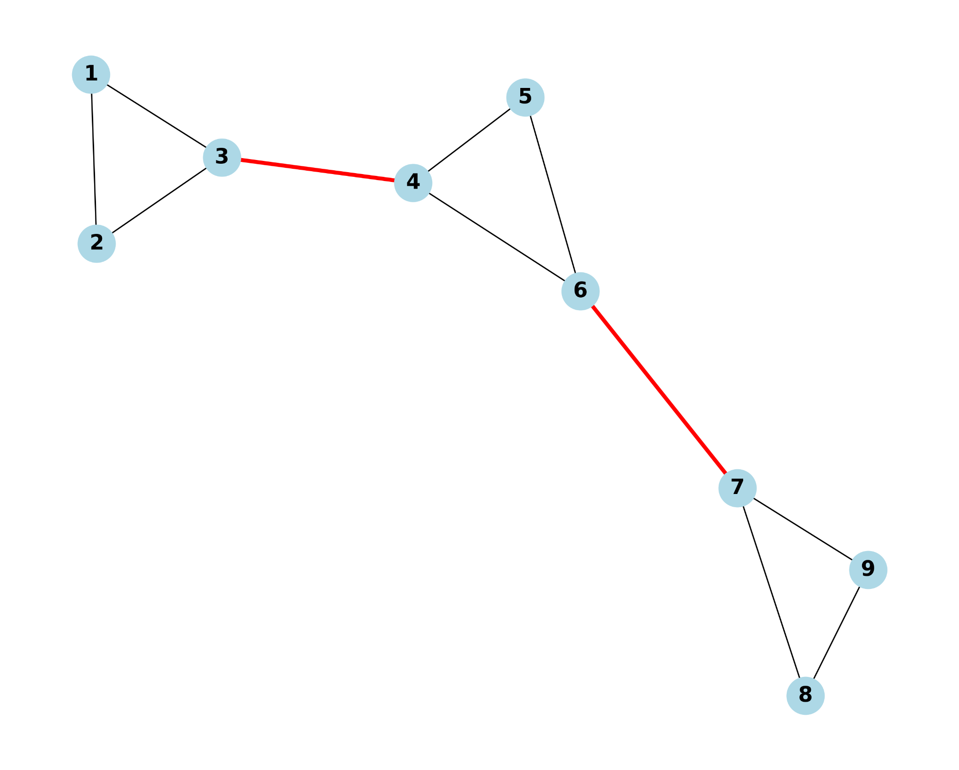

Minimum Feasible Partition Problem
A feasible partition P of a graph G = (V, E) is a partition of the vertex set V into two or more subsets {V₁, . . . , V_{kp}}, such that each of the induced subgraphs G(V_{i}) is connected.
E(P) is the edges between components of the partition P.
k_{p} is the number of components after removing E(P).

Slide 3



Modulus of Spanning Trees
Minimum Expected
Overlap Problem
Fairest Edge Usage Problem
Spanning Tree Modulus
(Albin et al. 2018) solves the minimum feasible partition problem where 𝜼* is the optimal solution to the fairest edge usage problem.

Slide 4

Goal: Train GNN to predict E(P) in MFP problem and use saliency analysis for feature importance

Slide 5
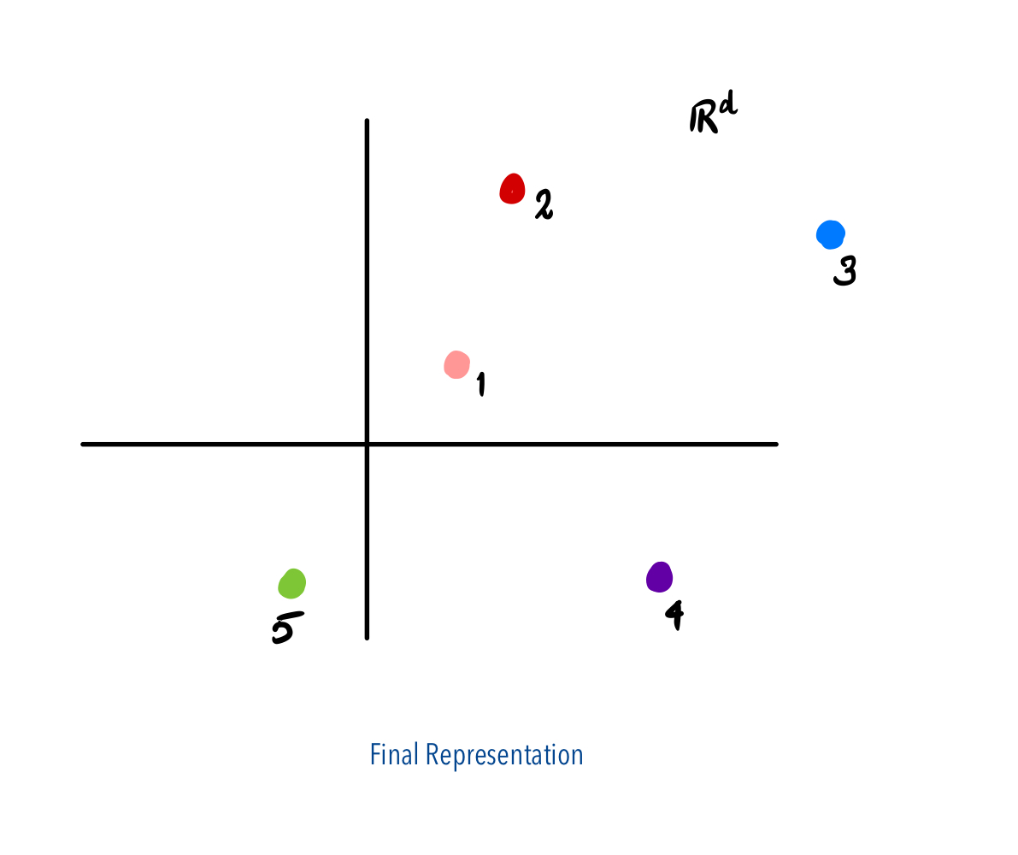
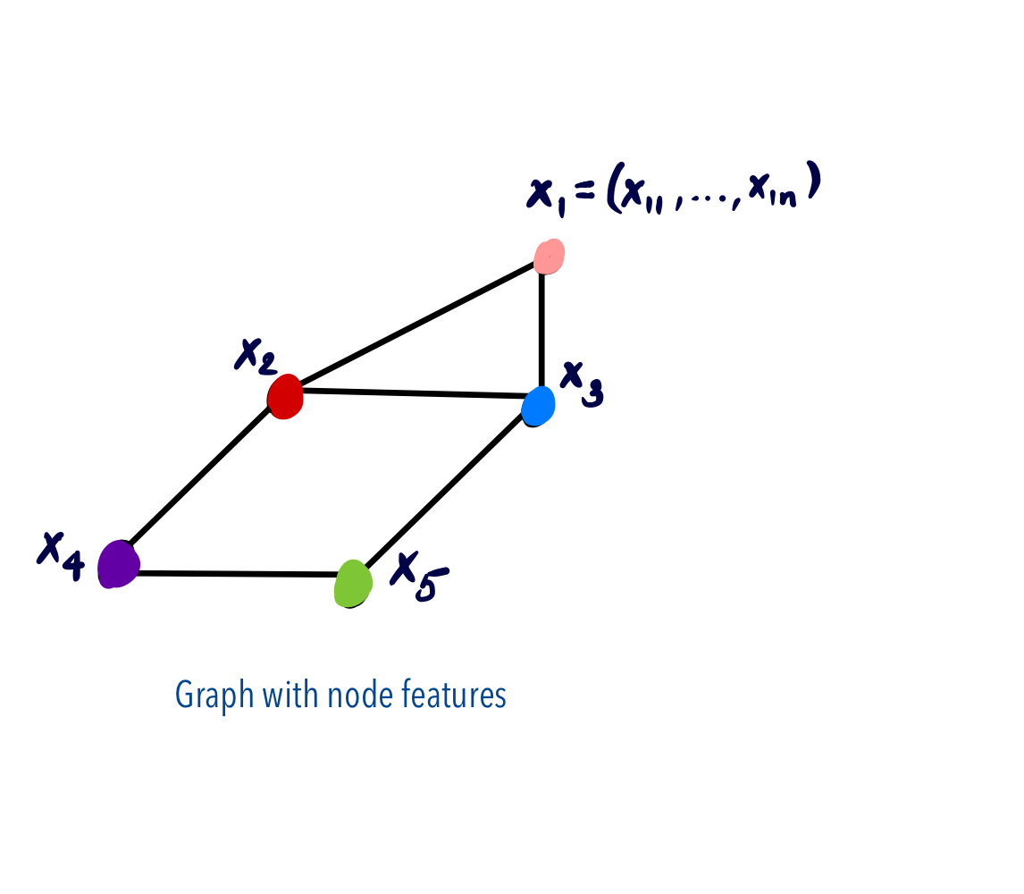
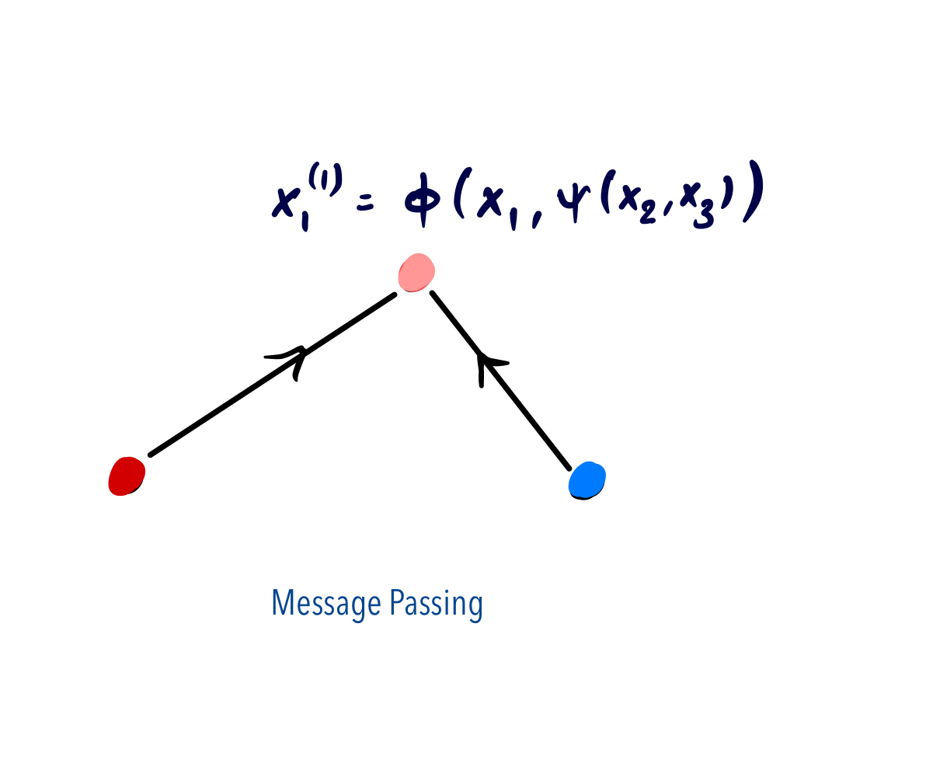
Graph Neural Networks
"GNNs are to graphs what Convolutional Neural Networks are to images - a fundamental building block for deep learning on a critical data structure." — Will Hamilton

Slide 6
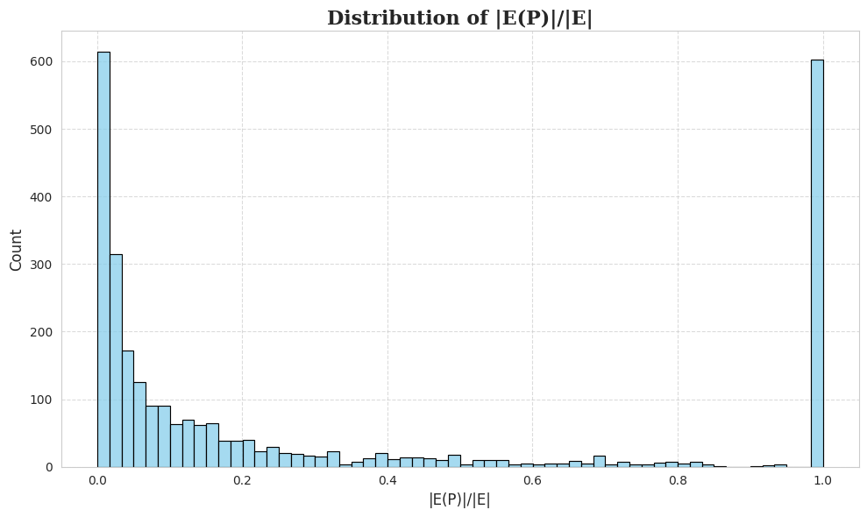
Dataset
2800 random geometric and erdös-renyi graphs of sizes 10-100.
Node Features:
Degree
Betweenness
Closeness
Clustering
Resistance curvature
Laplacian eigenvalues
Thanks to Beocat Computing Cluster at K-State High-Performance Computing (HPC) cluster at Kansas State University

Slide 7
Architecture
Input dimension: 15 (5 topological features + 10 lowest Laplacian eigenvalues)
Hidden Layers: 3 message passing layers
Dropout: 0.5
Optimizer: Adam
Prediction: - After final message passing layer, for each edge (u,v) concatenate the features of u and v and use one more linear layer + sigmoid for the prediction. - Threshold: 0.5
Loss: Binary Cross Entropy
Batch size: 16
Number of epochs: 201

Slide 8
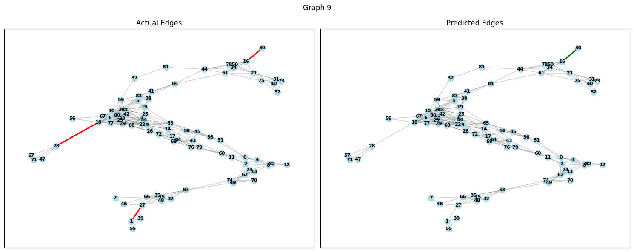
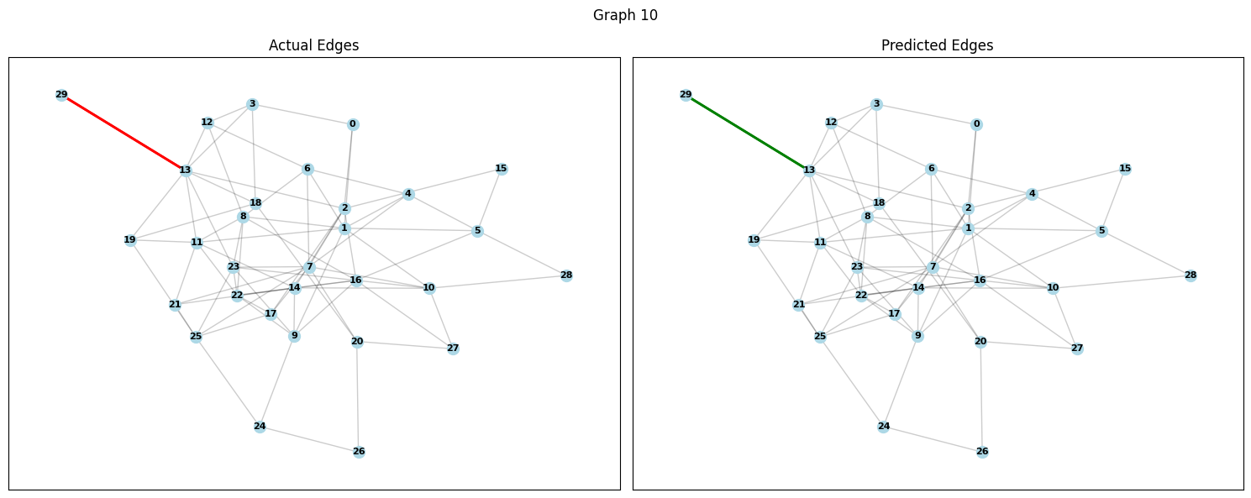
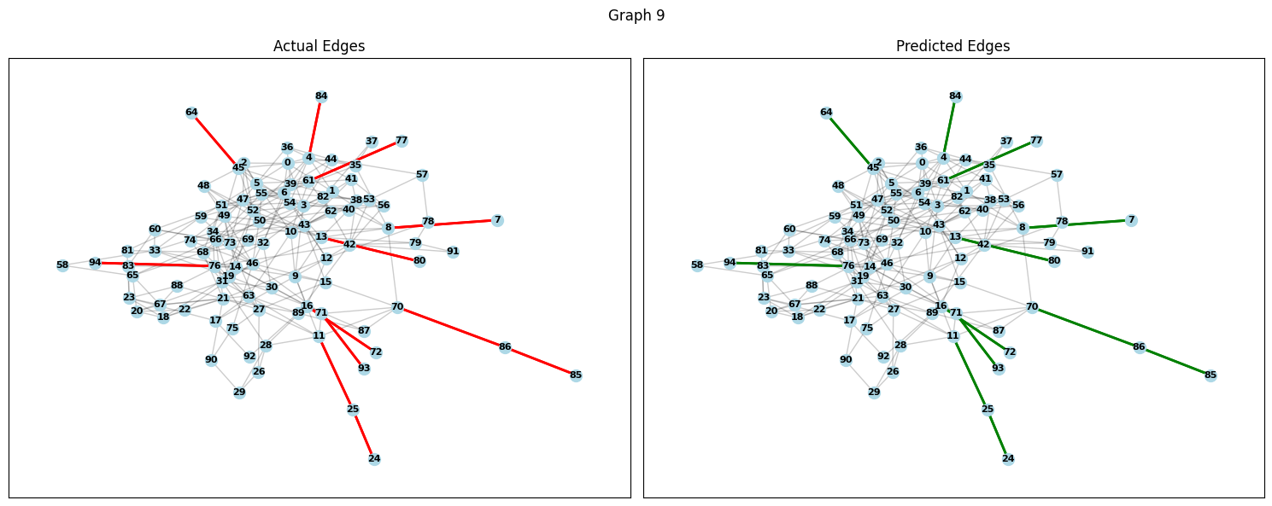
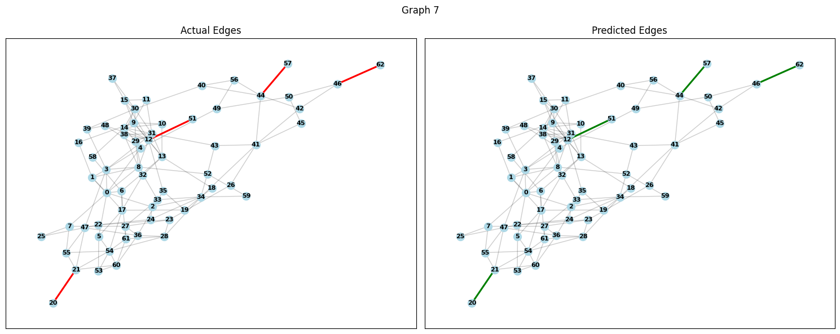
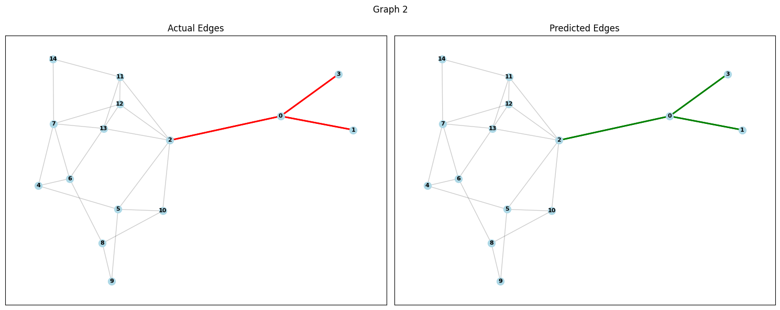
Model Predictions

Slide 9
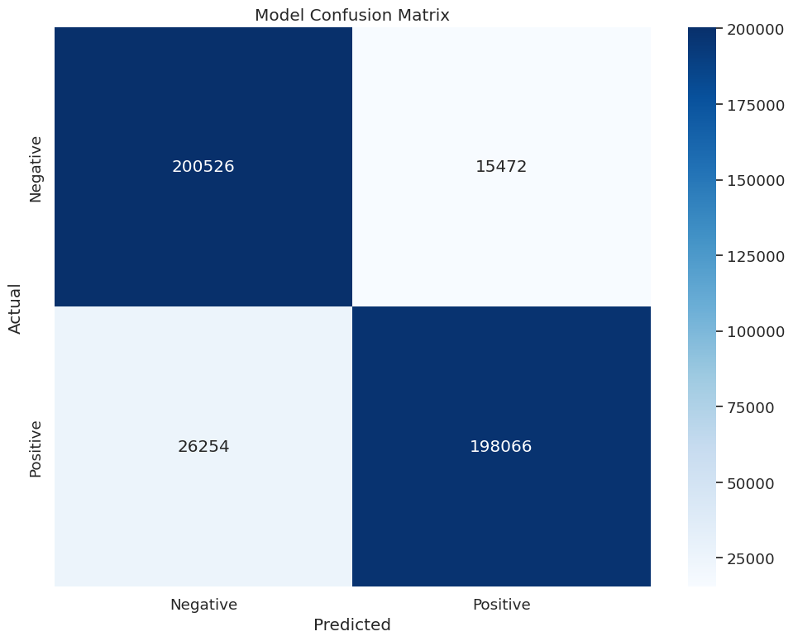
Model Results
Metric | Value
Accuracy | 0.90
Precision | 0.93
Recall | 0.88
F1 Score | 0.90

Slide 10
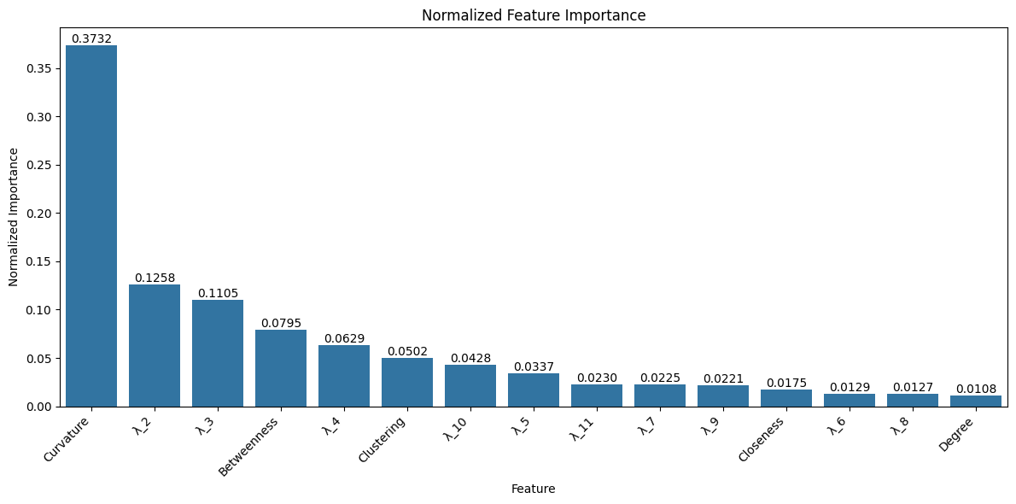
Saliency Analysis

Slide 11
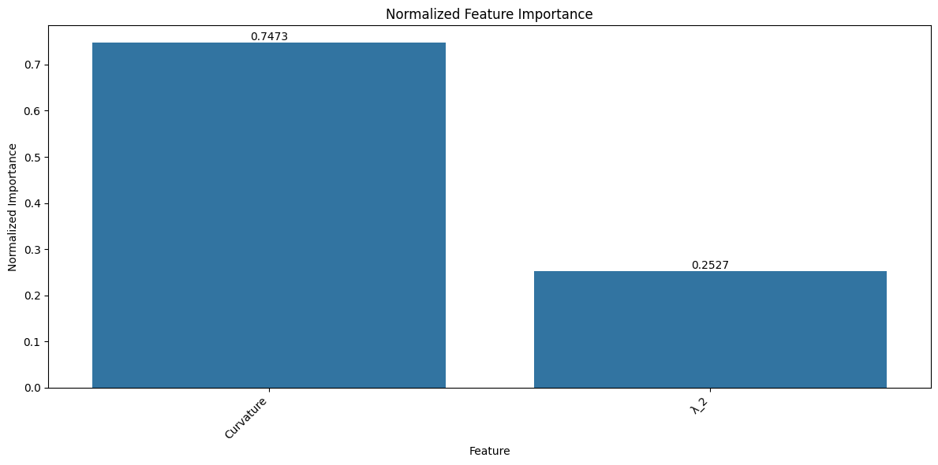

Best Model
Metric | Value
Accuracy | 0.93
Precision | 0.92
Recall | 0.94
F1 Score | 0.93

Slide 12
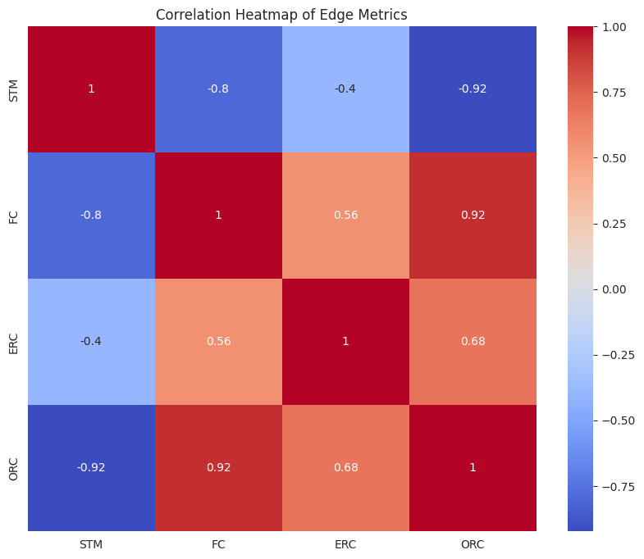
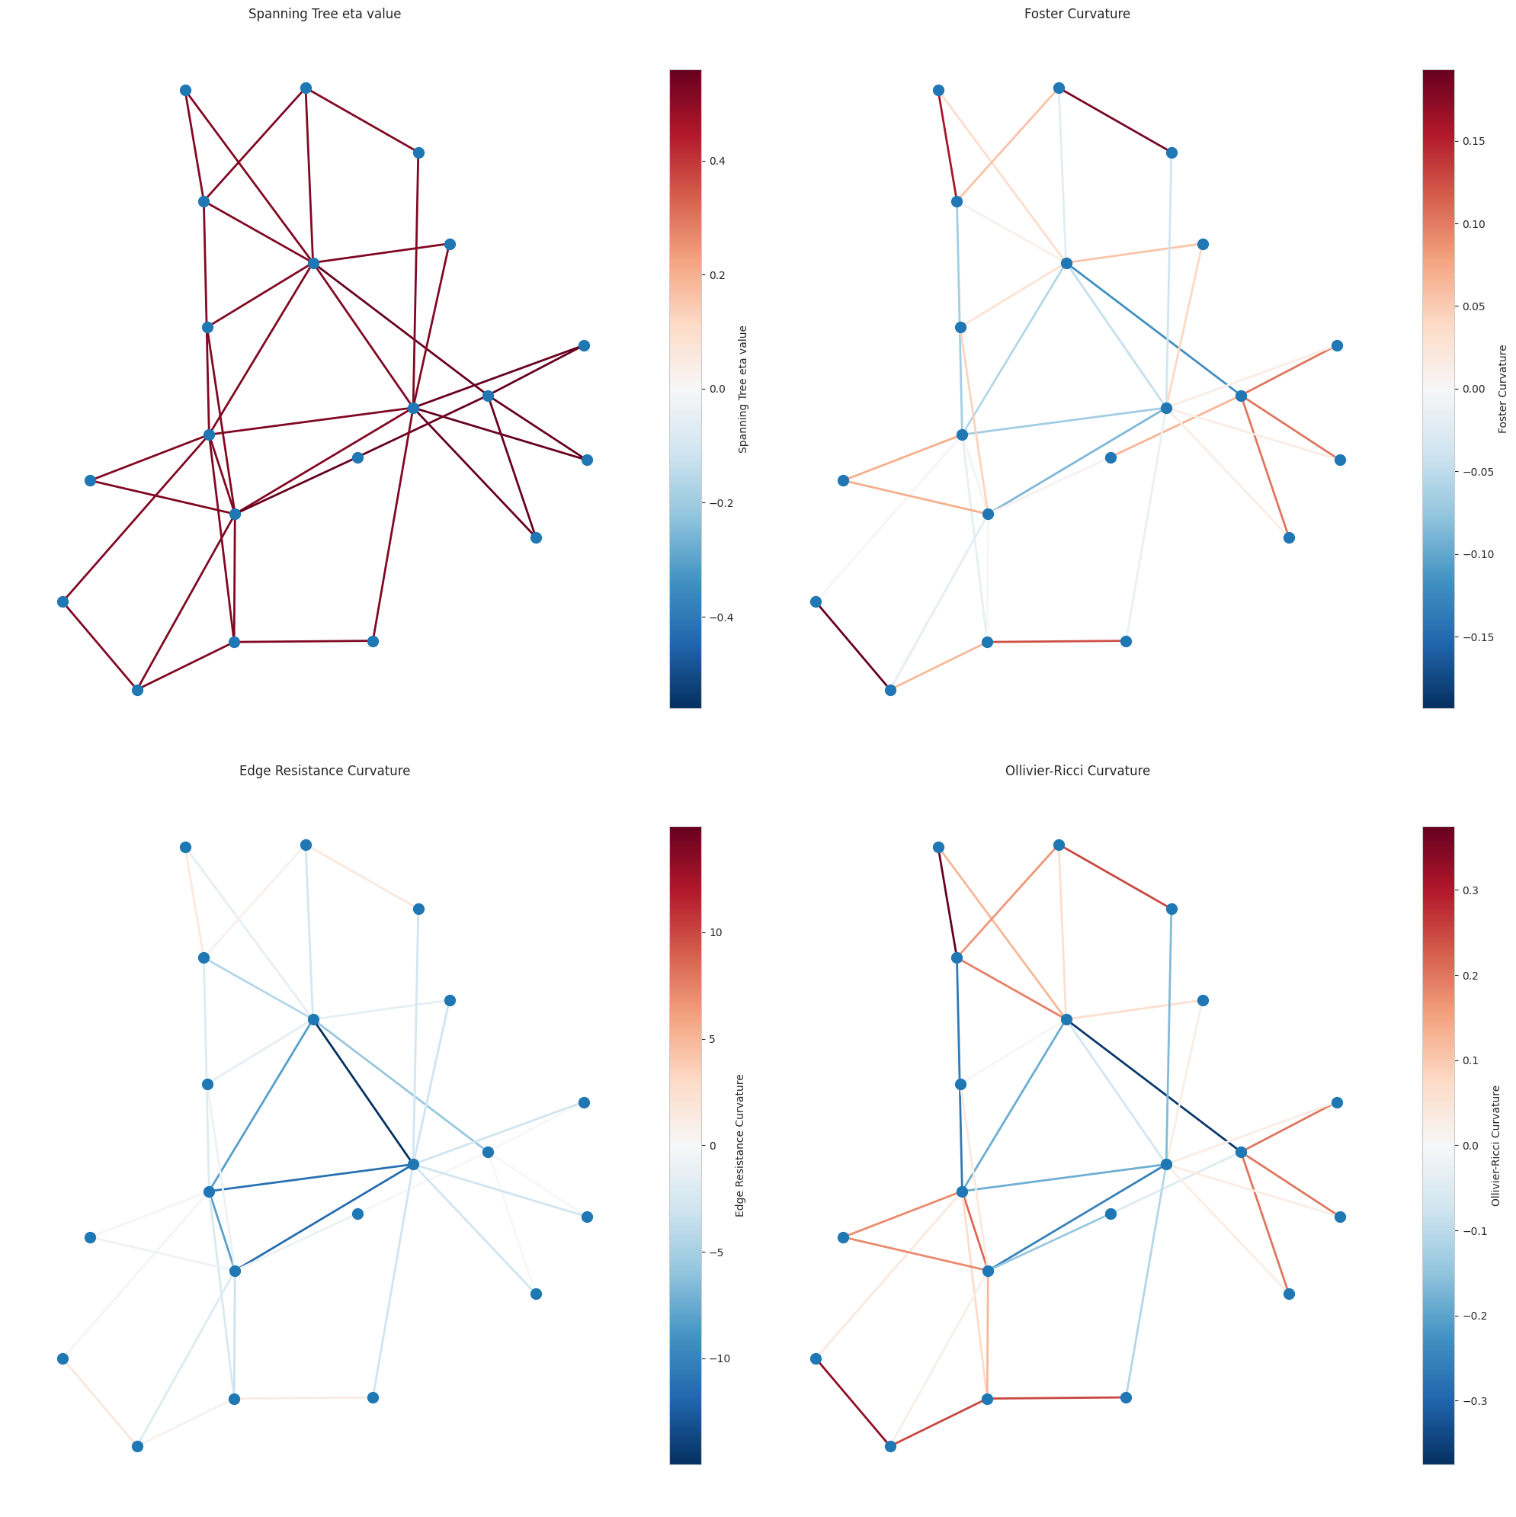
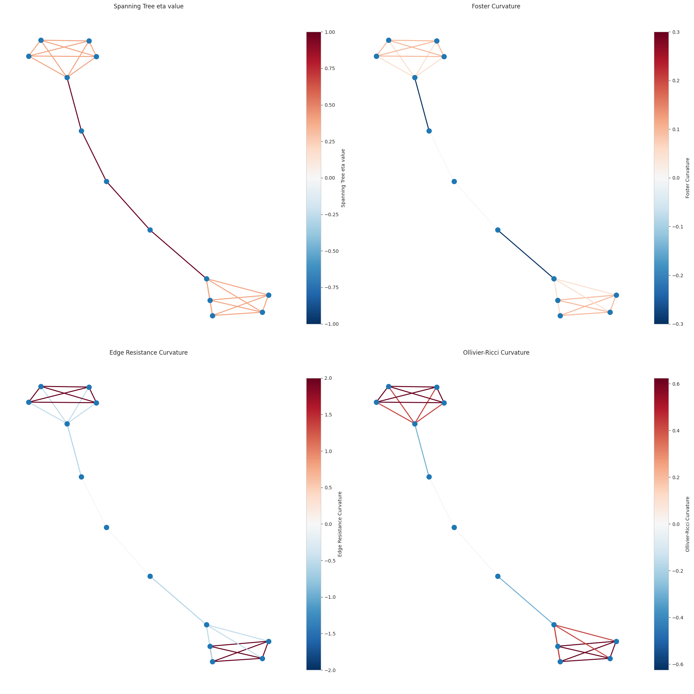



Relation to curvature?
Foster Curvature
$$FC\left(u,v\right)=\frac{1}{deg⁡(u)}+\frac{1}{deg⁡(v)}−EffRes(u,v)$$
Edge Resistance Curvature
$$ERC\left(u,v\right)=2\frac{pu+pv}{EffRes(u,v)}$$
Ollivier-Ricci Curvature
$ORC\left(u,v\right)=1−W(µu$, $µv)$

Slide 13
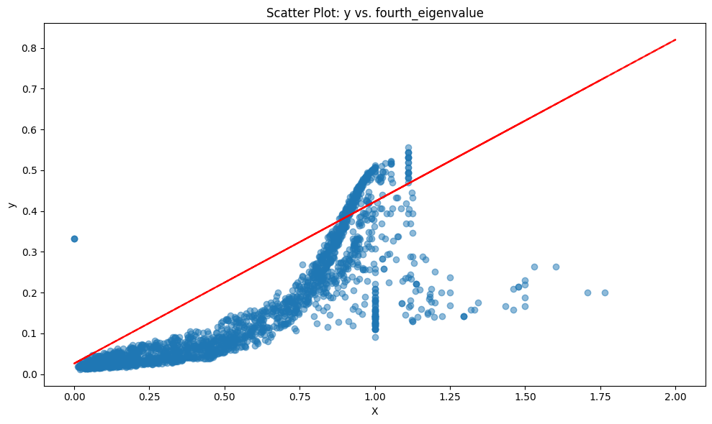
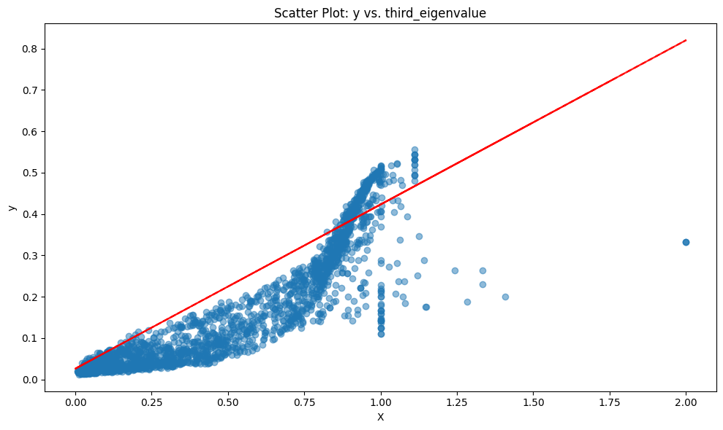
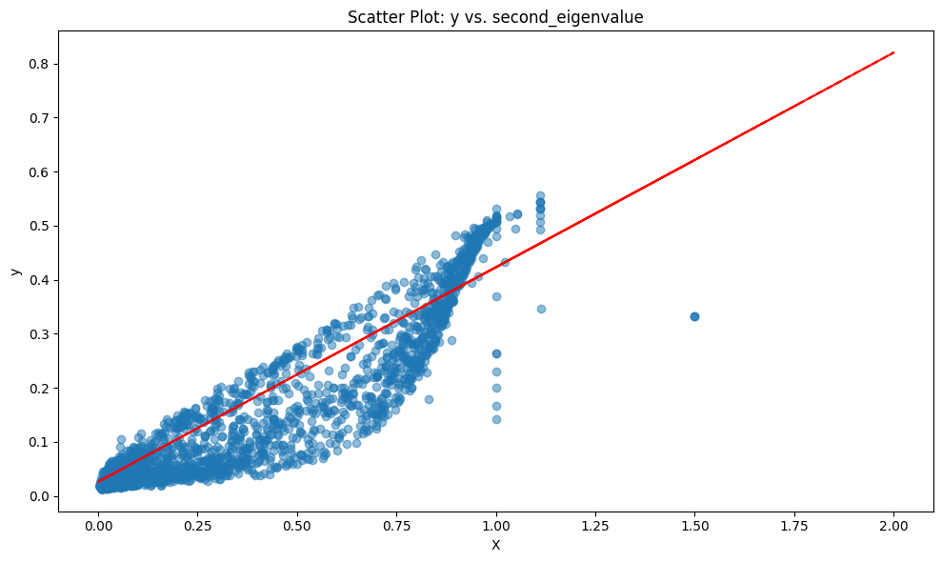
Relation to Eigenvalues ?

Slide 14

Preliminary Conjecture

Slide 15
Conclusion/Future Work
We hope to find a precise relation between modulus and discrete curvature.
Saliency analysis from neural networks can uncover connections.
Graph neural networks can be used for many other problems in combinatorial optimization and network science.
We are also using neural networks for other problems in modulus like modulus of loops in graphs.

